Slide 1
Intro to C

Slide 2
So Where Are We Now?
We’ve taken apart a computer from the circuit level to the assembly-language level (and it’s not even mid-term)!
We know how to work those pieces
We’re ready to talk seriously about problem-oriented languages

Slide 3
Problem-Oriented Language
A language whose statements resemble terminology of the user application-oriented language rather than machine language.
In other words a language in which algorithms are expressed in human terminology (math, science, business) as opposed to machine implementation terms.
There have been and are lots of them.

Slide 4
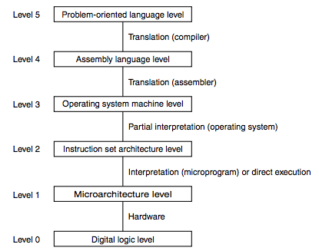
One More Abstraction…
These days, we even have abstraction layers within the problem-oriented language layer
Object-oriented Languages
(Java fits here)
Procedural Languages
(C fits here)

Slide 5
Problem-Oriented Language
Give Symbolic Names to Values
Provide Expressiveness
Abstract the Underlying Hardware
Enhance Code Readability
Provide Safeguards Against Bugs

Slide 6
Generations
Ancestors
Fortran
Algol 60
PL/I
Parents
(CPL, BCPL, B) -> C
Descendents
Perl
Java
Python
C++
C#

Slide 7
The C Language
BCPL (Typeless) - 1967 - Operating Systems
B - Ken Thompson - First version of Unix
C - 1972 - Dennis Ritchie - Implemented on PDP-11
Unix rewritten in C in 1974
Publication in 1978 of "The C Programming Language" by Brian Kernighan and Dennis Ritchie
...
ANSI C (1989)
Major updates to C standard in 1994 and 1999
We will use C99 in CS 2110 (GNU C compiler)

Slide 8

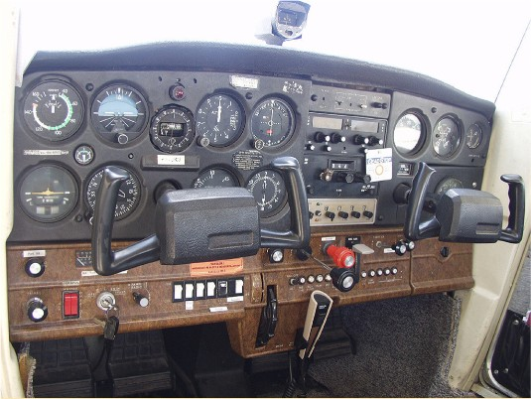
Learning to Program
CS1

Slide 9

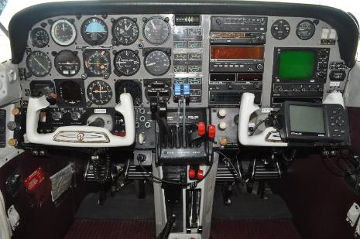
Learning to Program
CS2

Slide 10


So We’re Ready for a Fast, Modern Jet, Right?
CS2110

Slide 11
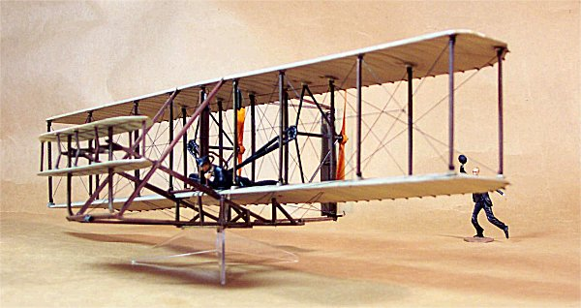
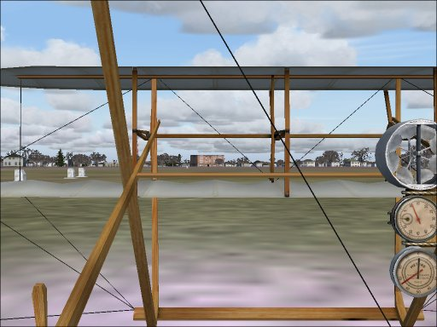
Well, C is More Like…
CS2110

Slide 12
C
C is the language that will allow you to do anything.
It is used to write operating systems, other languages, low level hardware drivers, cryptography, networking, etc.
It was designed to be easily compiled and to product compact, efficient code
It won't check for many runtime errors
Remember: It was invented to implement system software for a small computer

Slide 13
C
C is not your friend
C trusts you and will do exactly what you ask: It is quite certain you are a careful, knowledgeable programmer. Don’t disappoint it!
All the symbols mean something!
"I'll just type something in and the compiler will fix it for me” just won't work
Read and reread the C book! And there are plenty more tutorial resources on the net

Slide 14
Languages
Many problem-oriented programming languages have features that try to prevent the programmer from doing something wrong or letting you know when you do, e.g.
Java does not allow you access memory by address
Java throws an exception when you have an array out of bounds
C is not one of these languages. Why?

Slide 15
Differences Between Java and C
C is about 50 years old and pre-dates Java by about 25 years
C is procedural; no objects or classes
C structs are used in place of classes
Pointers are used in place of object references
No overloading of function names; each function must have a unique name
C does not include a native string datatype
Strings are arrays of characters
And characters are 8-bit integers
C does not have print or I/O built-in
For strings and printing, use standard C libraries

Slide 16
Expressions and Control Statements
Expressions are very similar
All expressions (including assignments) yield a value.
Order of precedence is the same
No “new” ,“instanceof”, or >>> (from Java)
C does have: “sizeof”, unary &, unary * and binary ->
Control statements are quite similar
Old friends “if”, “while”, “do-while”, “for”, “switch”, “break”, “continue”, “return”

Slide 17
Getting Ready for HW 7
We’re going to introduce several topics that you’ll need to complete Homework 7.
You are going to take the terms and examples we present and look them up in K&R, Patt, and/or the internet to get clarification if you need it.
Then, after Homework 7 is started, we’ll come back and look at some of these topics in more detail.

Slide 18
What We Need for HW 7
We’ll do these topics first:
Data types
Strings
printf()
C preprocessor (#define, #include)
Structs
Pointers
Functions
Command Line Arguments (argc, argv)

Slide 19
Data Types
Integer types
[unsigned] char 8 bits
[unsigned] short [int] 16 bits
[unsigned] int 16/32 bits
[unsigned] long [int] 32/64 bits
[unsigned] long long [int] 64 bits
Floating point types
float 32 bits
double 64 bits
long double 80/128 bits
Aggregate types
array
struct
union (later)
Pointers (a special kind of integer)

Slide 20
How Big? It Depends.
It depends on your platform
char – exactly 8 bits
short int – at least 16 bits
int – at least 16 bits
long int – at least 32 bits
You can tell with sizeof
sizeof is a compile-time constant reflecting the number of bytes held by a data type or instance
sizeof(char) <= sizeof(short) <= sizeof(int) <= sizeof(long)
sizeof char is 1.

Slide 21
Booleans
C historically did not have a Boolean data type.
Instead, we can use integers to represent Boolean values.
Any integer that is 0 evaluates as False
Any non-zero integer evaluates as True
Also applies for a char
Remember a char is just an 8-bit int in C
So the NUL character ‘\0’ evaluates to False
Also applies for a pointer
A memory address that is 0x0 evaluates as False
More on this later!

Slide 22
Strings
Strings are arrays of characters
Strings end with an ASCII NUL (a.k.a. 0 or ‘\0’)
You can define them like this char mystr[6];
You can initialize them several ways char mystr[6] = { ‘H’, ‘e’, ‘l’, ‘l’, ‘o’, ‘\0’ }; char mystr[] = { ‘H’, ‘e’, ‘l’, ‘l’, ‘o’, ‘\0’ }; char mystr[] = “Hello”;
The latter two are special cases in which the C compiler determines the length of the array from the initializer
There are a number of library functions for dealing with strings, including strlen(), strcpy(), and strdup()

Slide 23
Strings
char s[6] = “hello”;
Same as:
s .stringz “hello” ; 6 memory locations, ends with 0
s is the memory address where the string starts
Never use sizeof(s) when you want the string length!
That is the size of the array (or the size of a pointer), not the actual length of the string.
Use strlen(s) instead
Must #include <string.h> first

Slide 24
Question
In C, how many bits are the types short, int, and long?
Today's number is 98,065
16, 32, 64
32, 64, 64
32, 32, 64
Any of the above
10

Slide 25
Question
In C, a boolean value occupies
1 bit
8 bits
16 bits
32 bits
Any size an integer can be.
20

Slide 26
Question
In C, how do you declare and initialize an array to contain the string The quick brown fox?
char s[20] = “The quick brown fox”;
char s[20] = {‘T’, ‘h’, ’e’, ‘ ‘, ’q’, ‘u’, ‘i’, ’c’, ‘k’, ‘ ‘, ‘b’, ‘r’, ’o’, ‘w’, ‘n’, ‘ ‘, ‘f’, ‘o’, ‘x’, ‘\0’};
char s[] = “The quick brown fox”;
Any of the above
30

Slide 27
printf()
printf() is a function in the Standard IO Library
(so you need to #include <stdio.h>)
The first argument is a format string
Characters in the format string are copied to standard output (which is typically connected to your screen)
Format codes beginning with % reference arguments that come after the format string, in order
If you want to end a line, you need to output a newline character (‘\n’)

Slide 28
Printf() Format Codes
Some useful format codes are
For example printf(“Person: %s GPA: %f\n”, name, gpa); might print Person: Dan GPA: 2.5
%d | Decimal integer (int)
%x | Hex integer (int)
%f | Floating number (float)
%s | String (char * or char [])
%c | Character (char)
%p | Pointer (for debugging)

Slide 29
The C Preprocessor
The C preprocessor does two main things
File inclusion (#include)
Macro expansion (#define)
Preprocessor directives always start with #

Slide 30
#include
Conventionally, we only include files that end in “.h”
These consist of declarations (including function prototypes) and macro definitions but no executable code
If you surround the file name with
double quotes, the preprocessor looks in the current directory and then the system directories for the file
angle brackets (<>), it looks only in the system directories (e.g. “/usr/include”)
The lines in an #included file are literally copied in place of the #include

Slide 31
#include Example
#include <stdio.h>
#include <stdlib.h>
#include <string.h>
#include ”mylibrary.h"
NOTE:
These lines do NOT end in semicolon ;
They are NOT part of the C language
Rather, they are pre-processor directives
Header files typically contain
Macro definitions
Type Declarations
Function Prototypes
NOT Code!!!

Slide 32
Macro Processing
Macro processing is just text substitution using some very specific rules
We’re going to need to want to use symbolic names for constants in several places
For example #define NUL_CHAR ‘\0’ #define MAXWORDLEN 256
These symbolic names are textually replaced in the source code before it is compiled!
If you invoke the compiler with gcc –E, it will show you the pre-processed input file with all the includes and macros expanded
This is how we typically do constants in C.
Use a #define MACRO
(Macros are often ALL_CAPS by convention
But that is not required)

Slide 33
Macro Example
Continuing with our last example, we can write char buf[MAXWORDLEN];
… while (buf[i] != NUL_CHAR && i < MAXWORDLEN) i++;
After the C Preprocessor, the code literally becomes char buf[256]; … while (buf[i] != ‘\0’ && i < 256) i++;

Slide 34
Macros with Arguments
You can also use macros like functions (sort of).
#define PRODUCT(a,b) a*b
PRODUCT(4,5) would expand to 4*5
But what about PRODUCT(x+3,y+4) ?
Would expand to: x+3*y+4
Does that evaluate to what you intended?
Solution: fully parenthesize (order of operation):
#define PRODUCT(a,b) ((a)*(b))
PRODUCT(x+3,y+4) now expands to ((x+3)*(y+4))
REMEMBER: #define is a basically a text search-and-replace operation on your source code file (i.e., it’s not that smart).
Tip: There can’t be a space between the macro name and the left paren!

Slide 35
Structs
Structs look at lot like classes in Java – they are aggregate data types
They contain no methods
All data members are publicly visible
struct a {
int a, b;
char c[12];
int d;
};
a
b
c[12]
d
24 bytes – assuming sizeof(int) is 4 bytes

Slide 36
More on Structs
The struct tag declares the type struct car { char mfg[30]; char model[30]; int year; };
Names following the struct tag defines instances of the struct (i.e. allocate storage) struct car mikes_car, joes_car;
Identifier/function names and struct tags occupy separate name spaces. Struct members occupy a name space unique to the containing struct. That means that “struct b { int b} b;” is legal and not ambiguous.
NOTE:
The type is ‘struct car’
Not just ‘car’

Slide 37
You can declare a struct type, and define an instance (or multiple instances) of the variable at the same time.
struct car { char mfg[30]; char model[30]; int year; } mikes_car;
struct car is a data type
mikes_car is a variable of type struct car

Slide 38
Referencing Structure Members
NO!
The . operator is used just as in Java to reference members of a structure printf(“%s\n”, mikes_car.model); johns_car.mfg = “Chevrolet”;
NOTE:
You can’t assign a string literal to an array like this in C.
You can use strcpy() – a library function – and you must
make sure your destination has room to hold the source string.
Don’t forget to #include <string.h>

Slide 39
Referencing Structure Members
The . operator is used just as in Java to reference members of a structure printf(“%s\n”, mikes_car.model); strcpy(johns_car.mfg, “Chevrolet”);

Slide 40
Pointers
Can do the same things you can do with addresses in an assembly language
Powerful and potentially dangerous of course
No runtime checking (for efficiency)
Java avoids many of the features of pointers that cause problems, hence the decision to call them references. In Java:
No “address of” or “dereference” operator
No pointer arithmetic
No casting of integer types to pointer types

Slide 41
Pointers
Pointers contain memory addresses (or NULL)
Remember this from LC-3 assembly? B .fill 29 BADDR .fill B
In C, we can write it int b = 29; int *baddr = &b;
& is the “address of” operator; you use it to obtain a pointer to an existing data item

Slide 42
Using Pointers
To reference what a pointer points to, we use the dereference operator *
It acts like “indirect” in LC-3 loads and stores
In LC-3 assembly, if we wanted to use BADDR to access the value in B, we used LDI R1,BADDR ; get B ADD R1,R1,#2 STI R1,BADDR ; set B=R1
In C, we can write this as *baddr = *baddr + 2;
It literally does the same thing!

Slide 43
Another Example
Continuing our example with b and baddr,
printf(“%d\n”, b); *baddr = 18; printf(“%d\n”, b); printf(“%d\n”, *baddr);
prints
29 18 18
The value stored at b has been changed to 18; baddr still contains the address of b

Slide 44
* Has Two Meanings!
Don’t let the * in declarations confuse you about executable statements.
In a type declaration, * means “pointer to” and is part of the type
In an expression, * is the “dereference” operator – it acts like the “indirect” in the LC-3 loads and stores
When applied to a pointer, * makes the expression mean “What this pointer points to”
Declaration
int i, x;
int *px = &x;
Expression
i = *px;

Slide 45
Question
(declaration) = (expression)
int *ptrx = *y;
ptrx is a ”pointer to integer” so the expression *y must yield a type of “pointer to integer”
If we guess y is “pointer to integer”, then dereferencing with *y would yield type “integer”. No good.
If we guess y is a “pointer to pointer to integer”, then *y would yield type “pointer to integer”. That’s what we need, so earlier in the code, we should see
int **y;
Given the definition and initializer int *ptrx = *y; what must the type of y be?
pointer to a pointer to an int
pointer to an int
int
None of the above
Today’s number is 31,821
40

Slide 46
Pointers and Arrays
int a[10];
int *p;
a is an array, size 10, of int
p is a pointer to int (memory address)
In an expression, an array name becomes a constant pointer to the first element
e.g., a without [brackets]
a is the memory address where the array starts
a can’t be changed (but its contents can)
In other words, it’s the address of a[0] (or specifically &a[0])

Slide 47
Pointers and Arrays
int a[10];
int *p;
// legal
p = a; // p is the memory address of
// the start of the array
// illegal
a = p; // a is a CONSTANT pointer
// you are not allowed to change its value

Slide 48
Strings and pointers
char str[6] = “Hello”;
char *s;
Recall: a C string is really an array of char
When you see “char *”, think string (for now)

Slide 49
Pointer Arithmetic
You can add or subtract pointers and integers
a pointer plus or minus an integer yields a pointer
Just like adding to addresses on LC-3
with one additional semantic
int *p = &i; p = p + 1; is interpreted as p = p + 1 * sizeof(*p);
In other words, if p is an int pointer, p + 1 is the address of the next int – the address in p is incremented by the size of an int
For example:
int b[3] = { 9, 12, 13 }; int *p = &b[0];
The value of *p is 9, *(p + 1) is 12, and *(p + 2) is 13
In an expression, a[i] means exactly the same as *(a + i)
This is why the value of p[0] is 9, p[1] is 12, and p[2] is 13, just as above!

Slide 50
Pointer arithmetic and Arrays
These expressions are equivalent.
(an int)
a[5] *(a+5)
p[5] *(p+5)
int a[10];
int *p;
p = a;
These expressions are equivalent.
(pointer to an int)
&a[5] a+5
&p[5] p+5

Slide 51
Question?
3 72
72 3
7 12
12 7
3 3
72 72
12 12
12 72
72 12
x | y | px | py
3
 | 72
 |  | &x
 |  |  | &y
7
 |  |  | &x
12
int x = 3;
int y = 72;
int *px = &x;
int *py = &y;
*px = 7;
py = px;
x = 12;
printf("%d %d\n", *px, *py);
What is the output?
*px and *py both evaluate to 12 since they now both point to x!
50

Slide 52
Pointers and Structs
C supports the operator ->
The left operand must be a pointer to struct and the right operand a struct member.
It is literally a shorthand for * and . struct myStruct { int a, b; } *p; // p is a pointer to struct myStruct
(*p).a = (*p).b; p->a = p->b;
Same meaning

Slide 53
Functions
int mult(int a, int b) {
return a*b;
}
Two arguments (int), pushed on the stack
Returns an int
Pass by value always (not by reference)
Copies of arguments are pushed on the stack

Slide 54
Functions: main()
int main(int argc, char *argv[]) {
return 0;
}
main() is just another function
It is the first function invoked when you run your program from the command line
Convention: return 0 on success, or non-0 on error
Hint: type echo $? in the Linux shell to see the return value from main()

Slide 55
Functions: void
void func(void) {
printf(“Hello\n”);
}
void is a special keyword
Return type void:
function does not return a value
Arguments of void:
function takes no arguments

Slide 56
Functions: arrays as arguments
char s[10] = “Hello”;
void test(char *s) { printf(“%s\n”, s); }
int main(int argc, char *argv[]) { test(s); test(&s[0]); }
To pass an array into a function, we pass a pointer to the first element
Note that an array name in an expression (function call) is automatically promoted to a pointer to its first element
This includes strings (arrays of char)
We did the same thing in assembly
Same meaning

Slide 57
Declare functions before you call them
Function Prototypes
We often put the main() function first
- But main() needs to know about the
functions it will call
- And they are defined below
So we add function declarations above main()
- They just have the name, ret type, and args
- And end in a semicolon
- These are “function prototypes”
int foo(int);
int bar(char *);
int main() {
foo(1);
bar(“Bye”);
}
int foo(int i) {
// Do stuff
}
int bar(char *s) {
// Do stuff
}
Function Definitions

Slide 58
Command Line Arguments
int main(int argc, char *argv[]) {
return 0;
}
argc is the number of arguments
Including the program name itself
Think “argument count”
argv is an array of strings
More properly, an array of pointer to char
Think “argument values”

Slide 59
Command Line Arguments
int main(int argc, char *argv[]) {
return 0;
}
If we call our program this way on the command line
$ ./myprogram cs2110 rocks
then
argc == 3
argv[0] is “./myprogram”
argv[1] is “cs2110”
argv[2] is “rocks”

Slide 60
A Quick Example: args.c
#include <stdio.h>
int main(int argc, char *argv[]) {
for (int i=0; i<argc; i++) {
printf("arg #%d: ‘%s’\n”, i, argv[i]);
}
}

Slide 61
Running Our Example
$ gcc args.c
$ ls
args.c a.out
$ ./a.out hello there
arg #0: ‘./a.out’
arg #1: ‘hello’
arg #2: ‘there’
$
The default name of an executable program from gcc is:
a.out
You can rename the executable with the –o flag
$ gcc –o args args.c
// the executable will now be named args
Or you can use mv to change its name:
$ mv a.out args

Slide 62
Examples: IntroToC
Download the IntroToC folder from Canvas>Files
args.c
strings.c
structs.c
segfault.c
Read the comments
Compile and run the code
Play with the code.
Try to do other similar things
Try to break it
Look at the next slide deck and try out gdb to trace through the code

Slide 63
A Quick Example
#include <stdio.h>
#include <stdlib.h>
int nfact(int n);
int main(int argc, char *argv[]) {
int a, f;
a = atoi(argv[1]);
f = nfact(a);
printf("%d! = %d\n", a, f);
return 0;
}
int nfact(int n) {
if (n < 2)
return 1;
return n * nfact(n - 1);
}

Slide 64
Running Our Example
$ gcc example1.c
$ ls
example1.c a.out
$ ./a.out 6
6! = 720
$ ./a.out 7
7! = 5040

